Slide 1

National Institute of Technology Calicut
TOPIC
HOSTELERS BAY
PROJECT GUIDE : SNEHA CP CREATED BY
DIKSHANT BIST
ARJUN BHARDWAJ
RAKHI KUMARI
RAVINDER SINGH

Slide 2


Slide 3
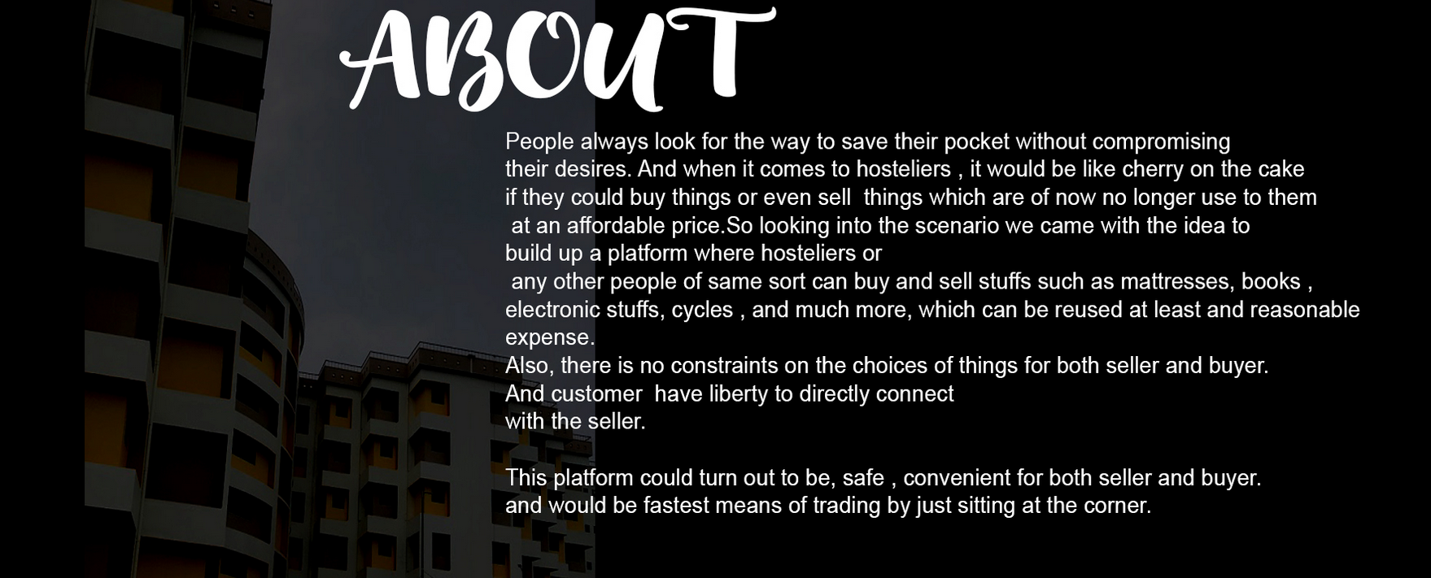

Slide 4
AIM
This platform basically centers around bringing easy and fastest
access of things needed at the peers at cheap and affordable price ,
thus avoiding rush and preventing the wastage of things that can be reused .
And also saving time avoiding
unnecessary haste.
.

Slide 5
Navigation Bar
1. Signup and Login
2. Users
3. Product
4. Category
5. About

Slide 6

Signup and Login

Slide 7
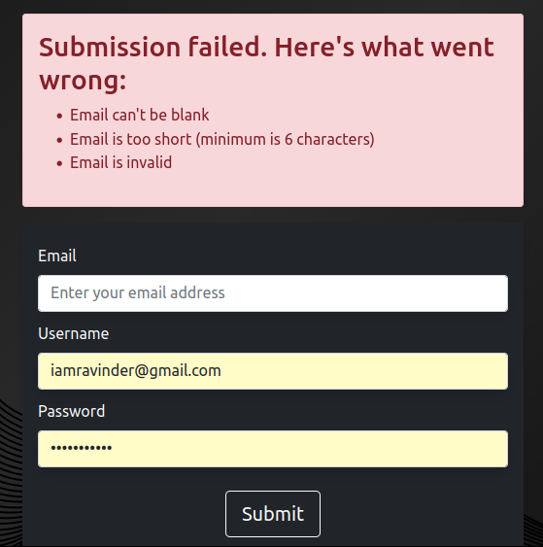

If the username already exist or Some fields are left blank.
Else sign up if everything is alright

Slide 8
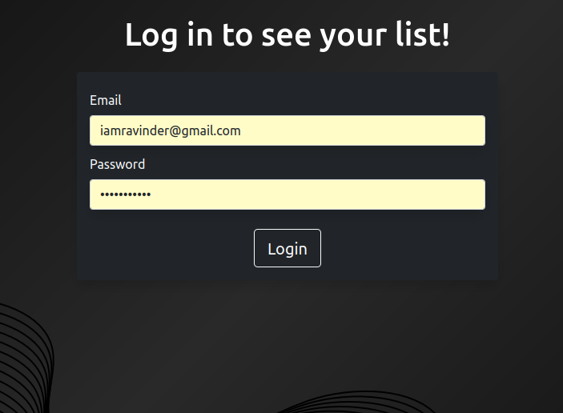

Slide 9
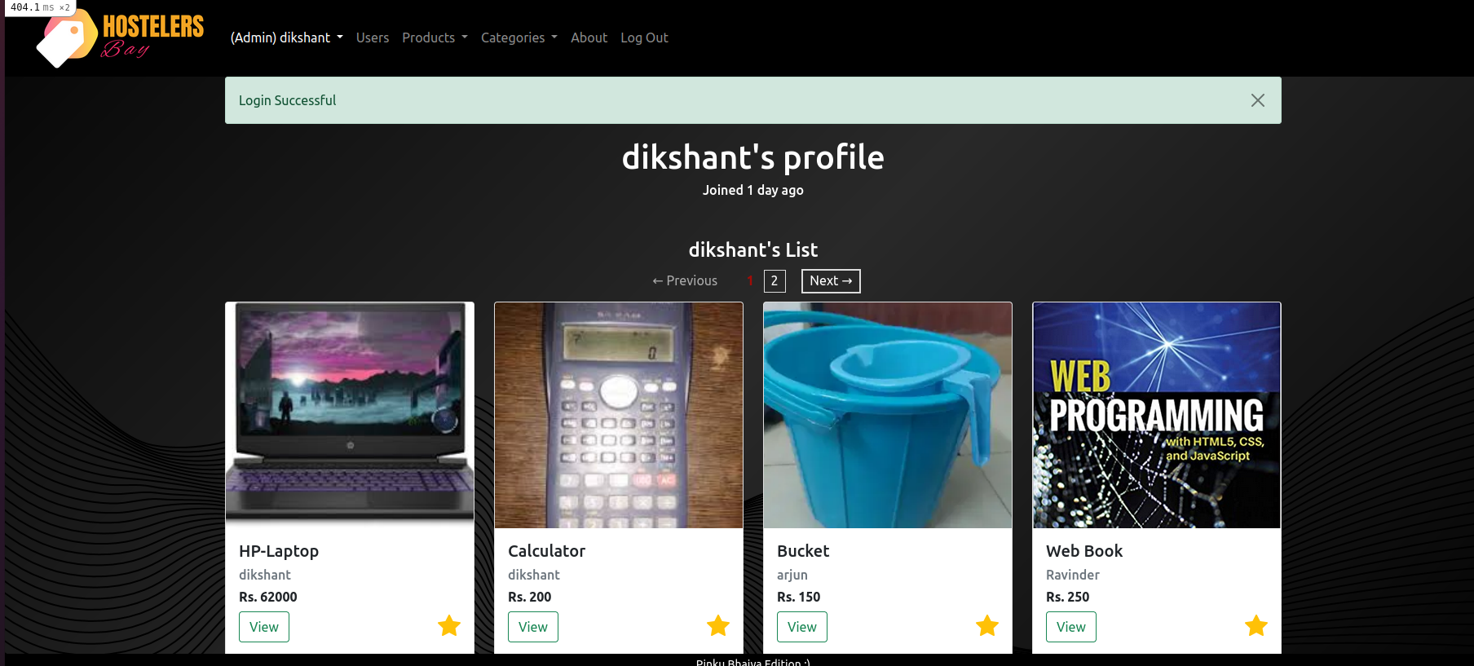
After Login

Slide 10
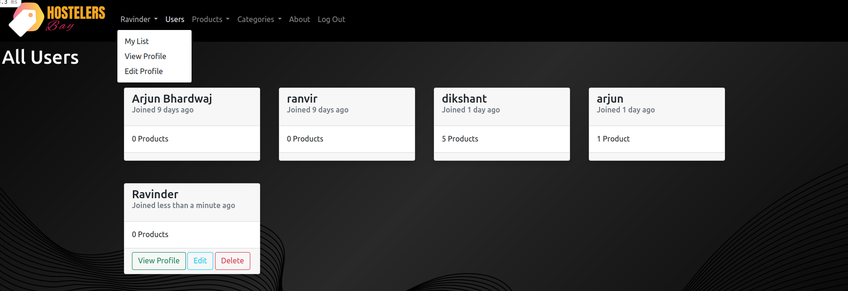
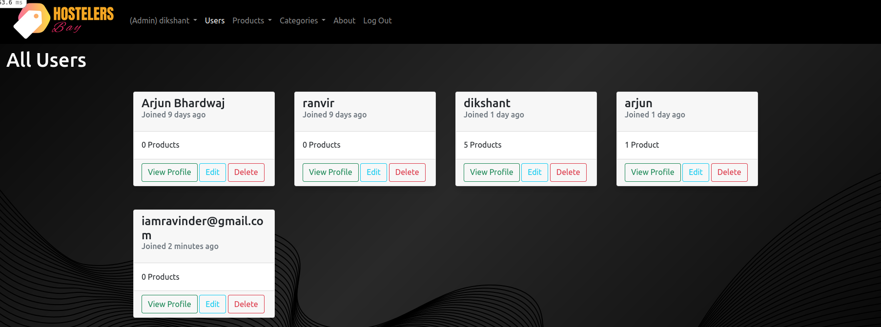
For user
For admin

Slide 11
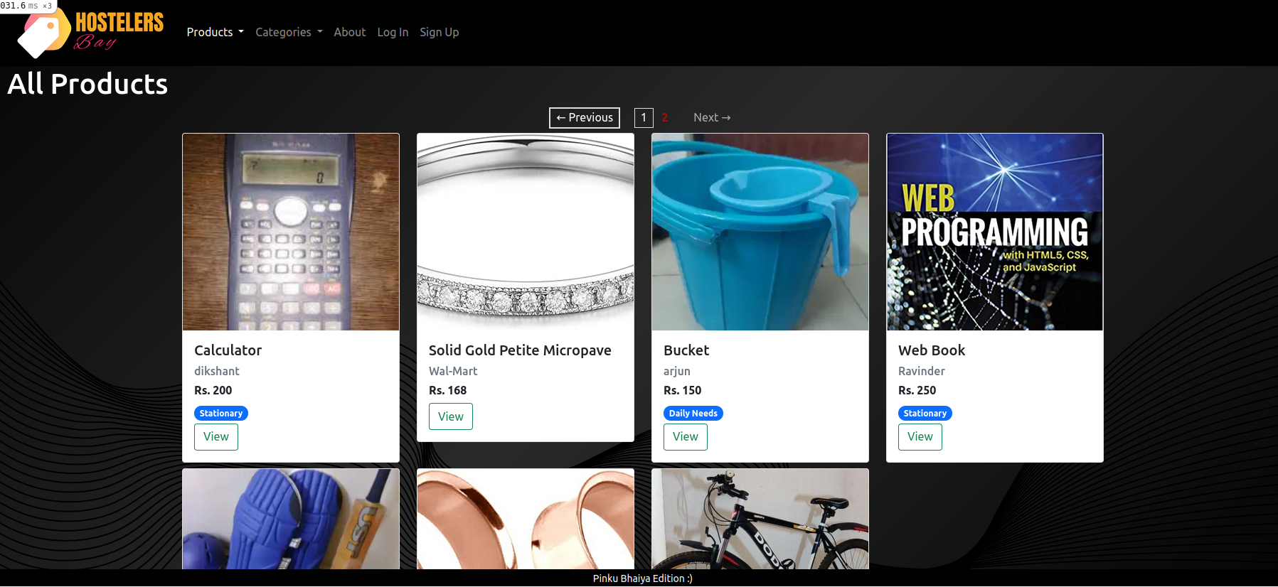
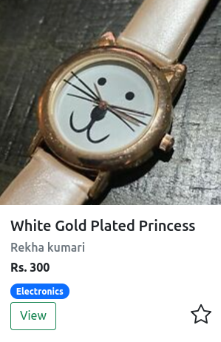
Products
Thank you
watch

Slide 12
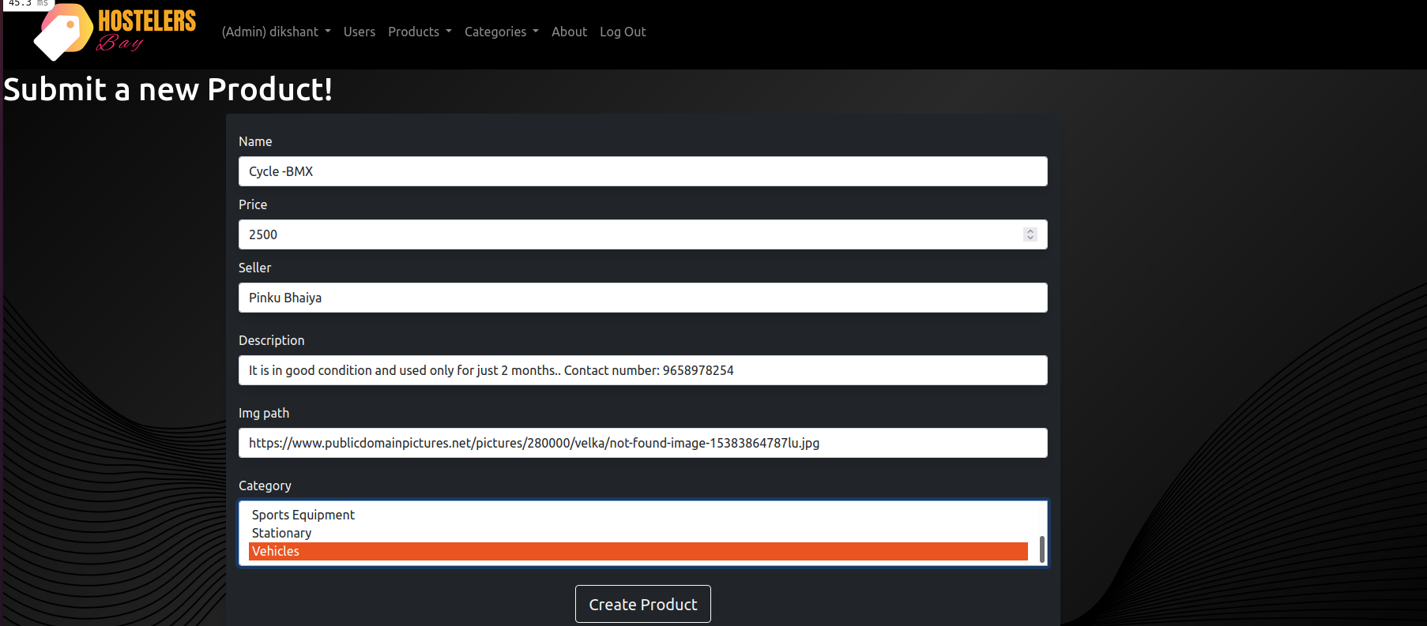
Creating New Product

Slide 13
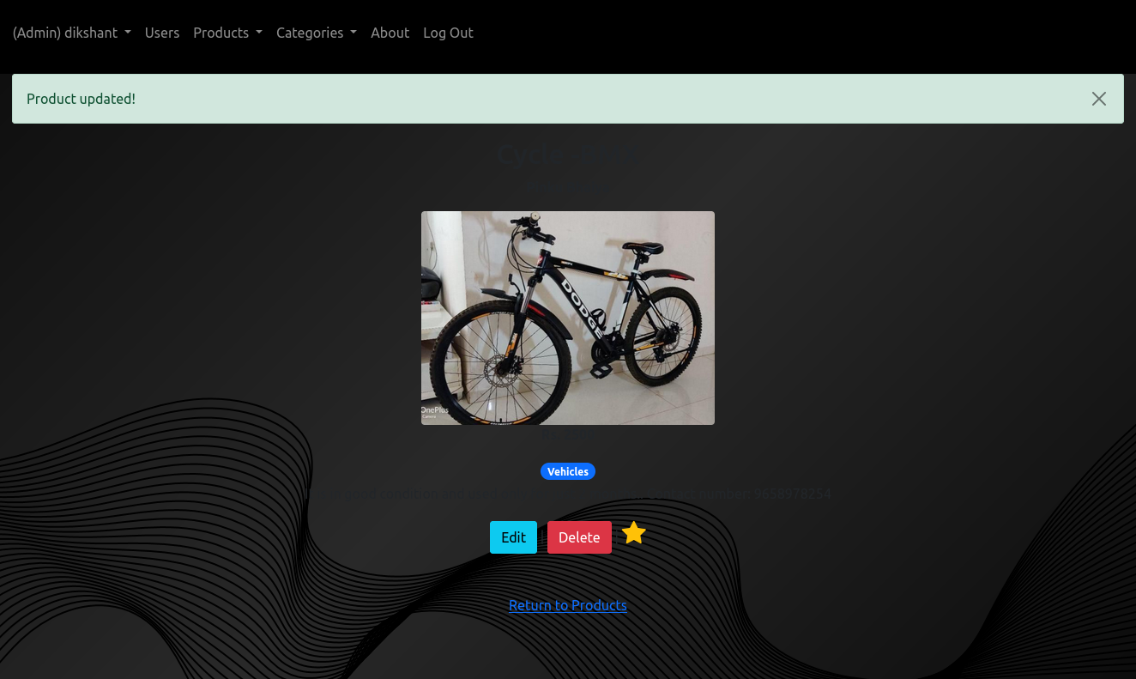
Navigation Bar
It is in good condition and used only for just 2 months. Contact number: 9658978254

Slide 14
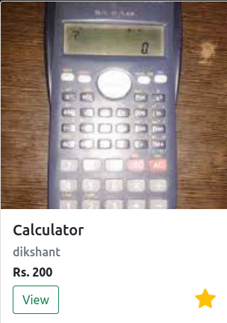
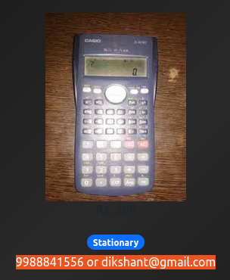
Purchasing Product
Step 1:
Select the required product then click on STAR SYMBOLL, the product will be added to our wish list
Step 2:
For purchasing, directly contact to seller through the contact number given in description of the product

Slide 15
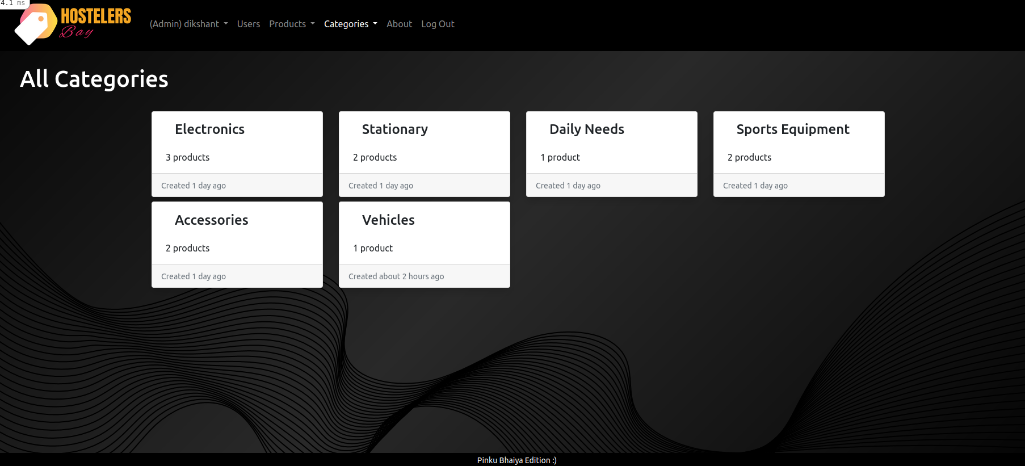
Categories Section

Slide 16
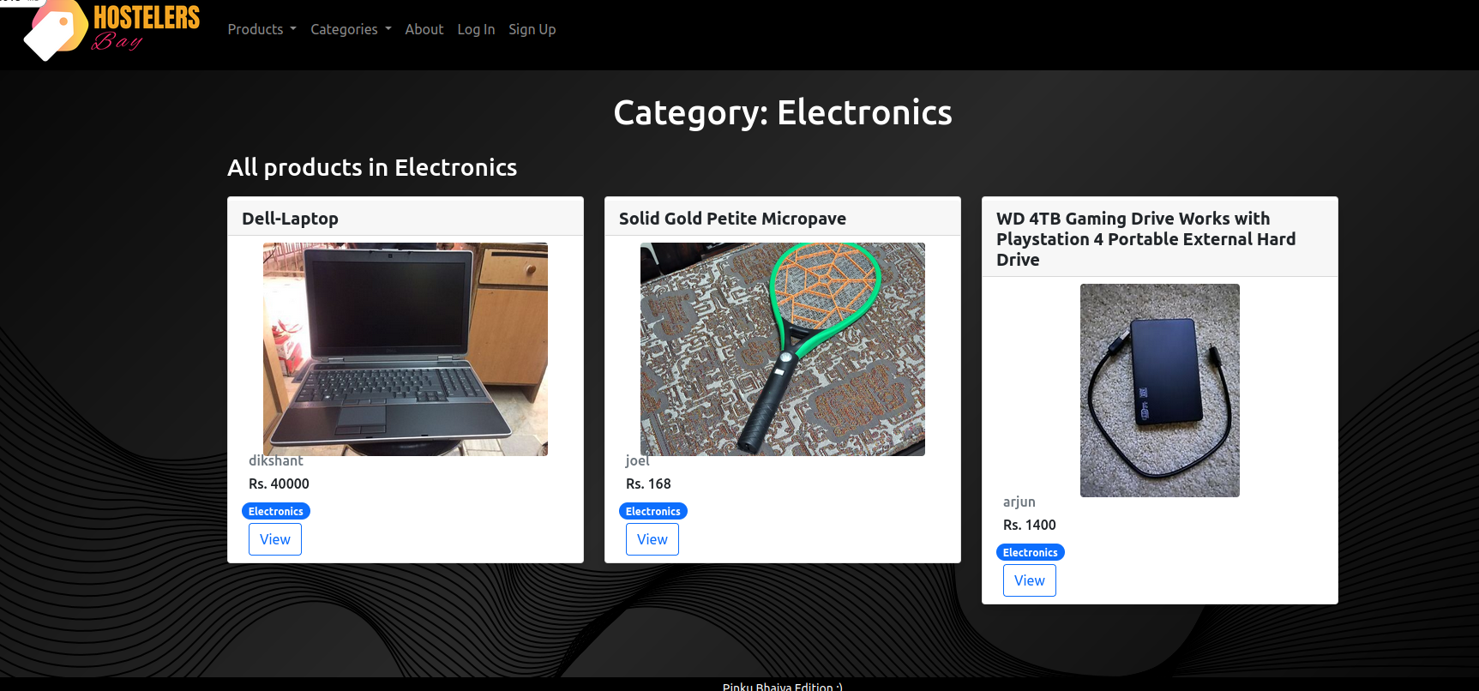

Slide 17
Thank you

